Slide 1
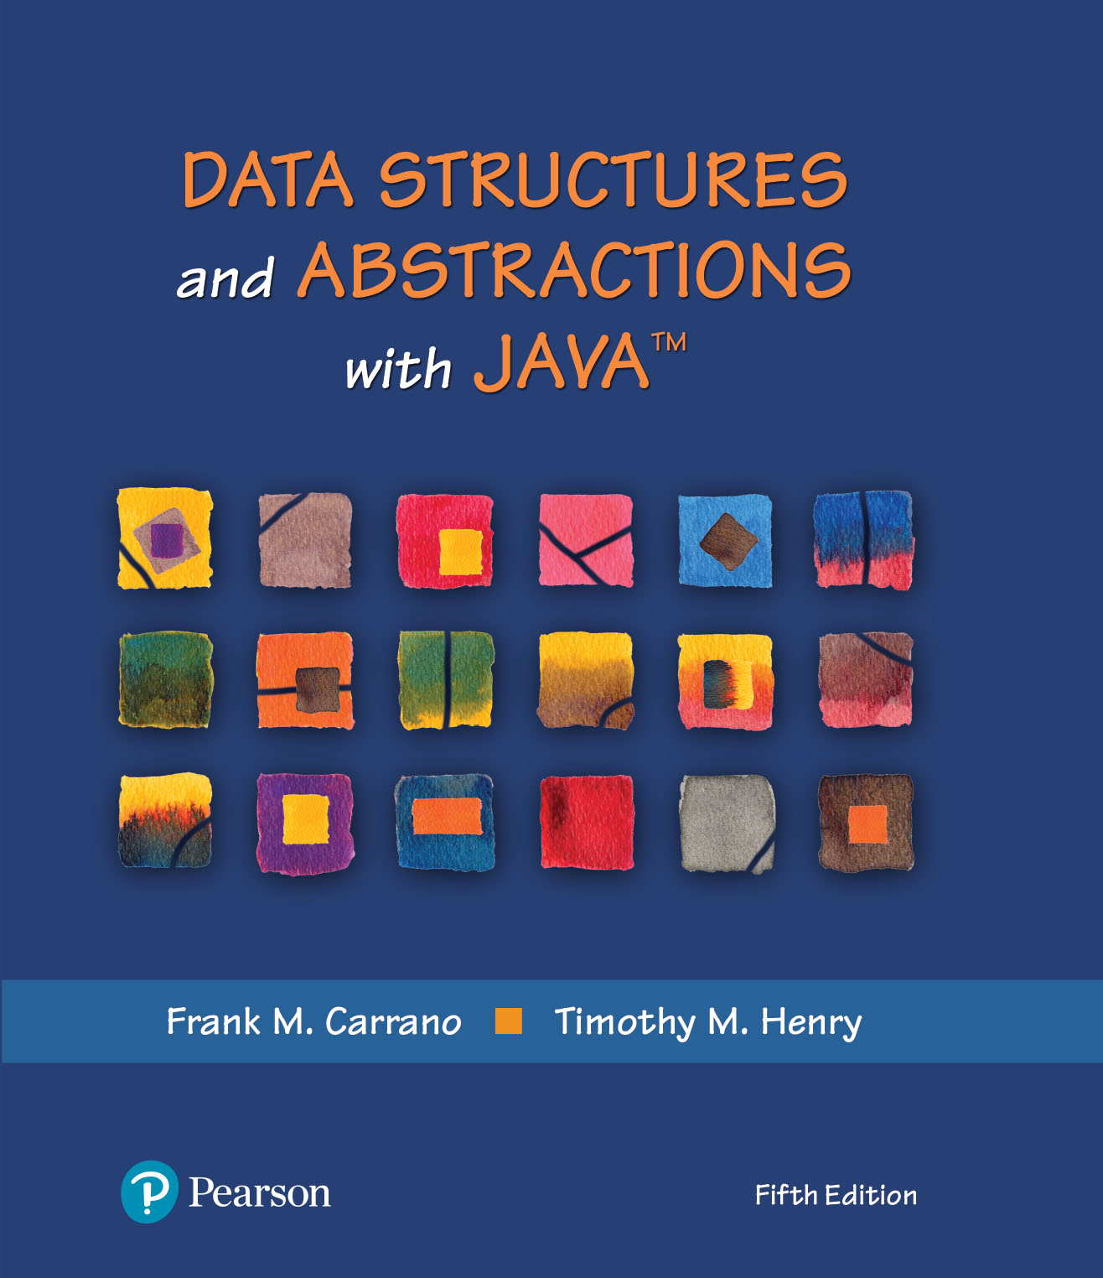
Data Structures and Abstractions with Java™
5th Edition
Module 15 - Cloning
Including:
Java Interlude 9 - Cloning

Slide 2
Cloneable Objects
A clone is a copy of an object
Typically, we clone only mutable objects
Sharing an immutable object is safe
So cloning it is usually unnecessary.
Class Object contains a protected method clone that returns a copy of an object
protected Object clone() throws CloneNotSupportedException

Slide 3
Cloneable Objects
clone is protected, and Object is the superclass of all other classes
Implementation of any method can contain the invocation
Clients of a class cannot invoke clone unless the class overrides it and declares it public
super.clone()

Slide 4
Cloneable Objects
public class Name implements Cloneable
// . . .
public Object clone()
{
Name theCopy = null;
try
{
theCopy = (Name)super.clone(); // Object can throw an exception
}
catch (CloneNotSupportedException e)
{
System.err.println("Name cannot clone: " + e.toString());
}
return theCopy;
} // end clone
Here is clone method for class Name (This is a shallow clone.)

Slide 5
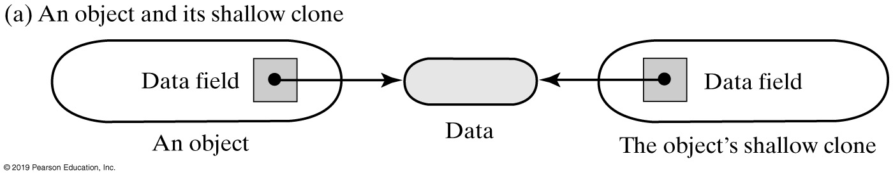
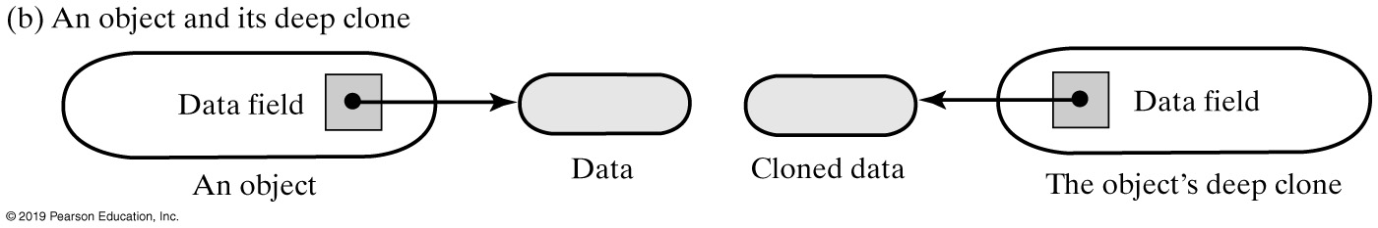
Cloneable Objects
FIGURE J9-1 Two clones of an object, shallow and deep

Slide 6
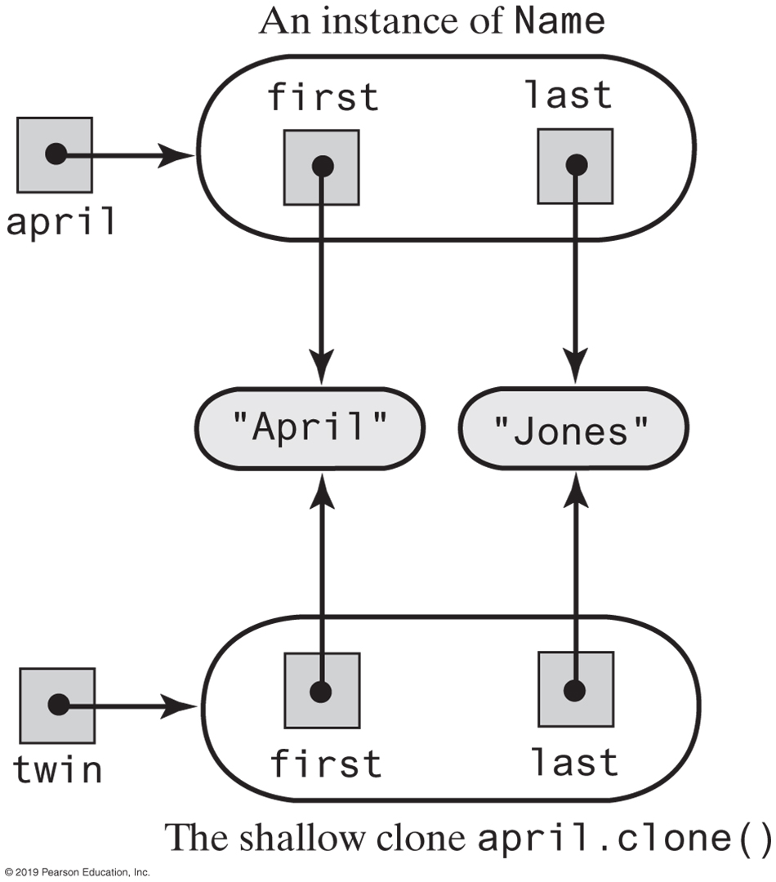
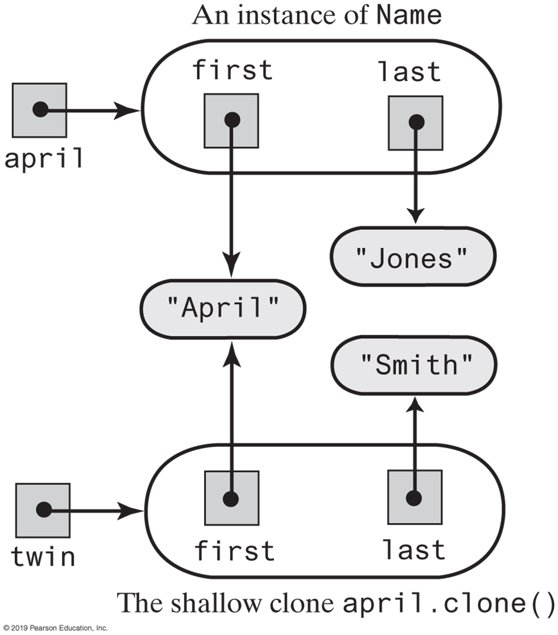
Shallow Clones
FIGURE J9-2 An instance of Name and its shallow clone
FIGURE J9-3 The clone twin, after the statement twin.setLast(“Smith”) changes one of its data fields

Slide 7
Cloneable Objects
/** A class that represents a student that can be cloned. */
public class Student implements Cloneable
{
private Name fullName;
private String id; // Identification number
/* Constructors and additional method, setters and getters . . . */
public Object clone()
{
Student theCopy = null;
try
{
theCopy = (Student)super.clone(); // Object can throw an exception
}
catch (CloneNotSupportedException e)
{
throw new Error(e.toString());
}
theCopy.fullName = (Name)fullName.clone();
return theCopy;
} // end clone
} // end Student
Define a clone method for the class Student

Slide 8
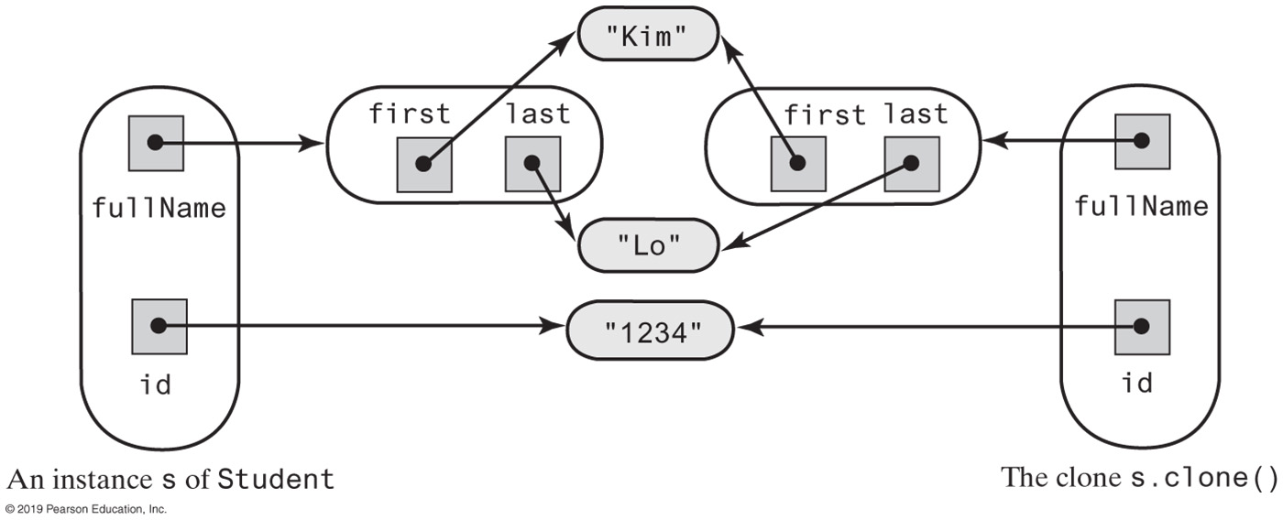
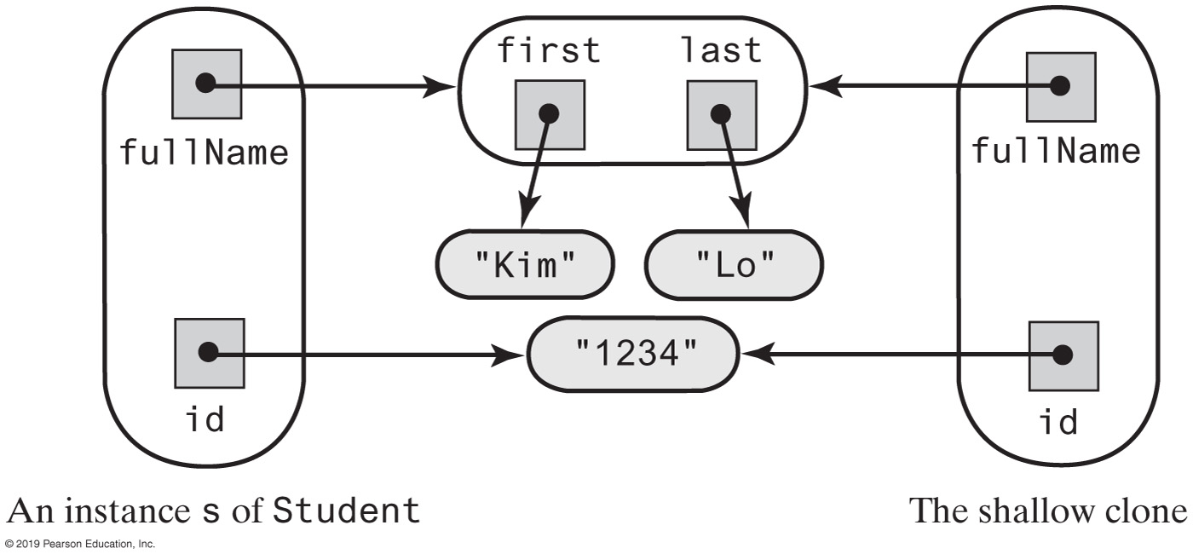
Deep Clones
FIGURE J9-4 An instance of Student and its clone, including a deep copy of fullName
FIGURE J9-5 An instance of Student and its clone, including a shallow copy of fullName

Slide 9
Cloneable Objects
/** A class that represents a college student. */
public class CollegeStudent extends Student implements Cloneable
{
private int year; // Year of graduation
private String degree; // Degree sought
/* Constructors and the methods setStudent, setYear, getYear,
setDegree, getDegree, toString, and clone go here.
. . . */
public Object clone()
{
CollegeStudent theCopy = (CollegeStudent)super.clone();
return theCopy;
} // end clone
} // end CollegeStudent
Add a clone method to a subclass of Student.

Slide 10
Cloning an Array
/** An interface for a public clone method. */
public interface Copyable extends Cloneable
{
public Object clone();
} // end Copyable
Define a new interface that declares a public method clone to override Object’s protected method
public class AList<T extends Copyable> implements ListInterface<T>, Cloneable
public class AList<T extends Copyable> implements ListInterface<T>, Copyable
public class AList<T extends Copyable> implements CloneableListInterface<T>
Then begin Alist one of different possible ways

Slide 11
Cloning an Array
public Object clone()
{
AList<T> theCopy = null;
try
{
@SuppressWarnings("unchecked")
AList<T> temp = (AList<T>)super.clone();
theCopy = temp;
}
catch (CloneNotSupportedException e)
{
throw new Error(e.toString());
}
/* For a deep copy, we need to do more here, as you will see
. . . */
return theCopy;
} // end clone
Outline for Alist’s method clone

Slide 12
Cloning an Array
public Object clone() {
AList<T> theCopy = null;
// Clone the list
try
{
@SuppressWarnings("unchecked")
AList<T> temp = (AList<T>)super.clone();
theCopy = temp;
}
catch (CloneNotSupportedException e)
{
throw new Error(e.toString());
}
// Clone the list's array
theCopy.list = list.clone();
// Clone the entries in the array (list[0] is unused and ignored)
for (int index = 1; index <= numberOfEntries; index++)
{
@SuppressWarnings("unchecked")
T temp = (T)list[index].clone();
theCopy.list[index] = temp;
} // end for
return theCopy;
} // end clone
Definition of method clone for class Alist

Slide 13
Cloning a Chain
public class LList<T extends Copyable> implements CloneableListInterface<T>
{
private Node firstNode; // Reference to first node of chain
private int numberOfEntries;
// . . .
Need a clone method to a linked implementation of the ADT list, such as class LList

Slide 14
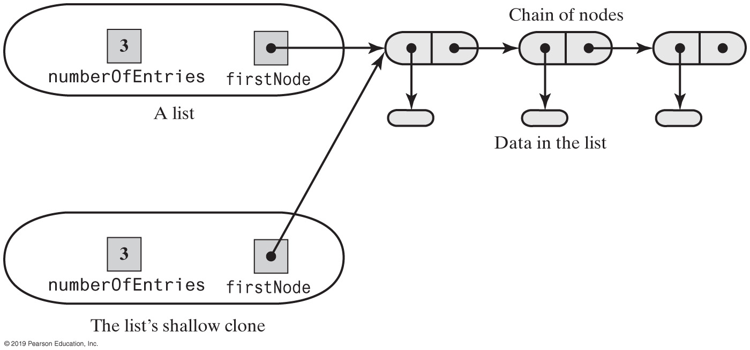
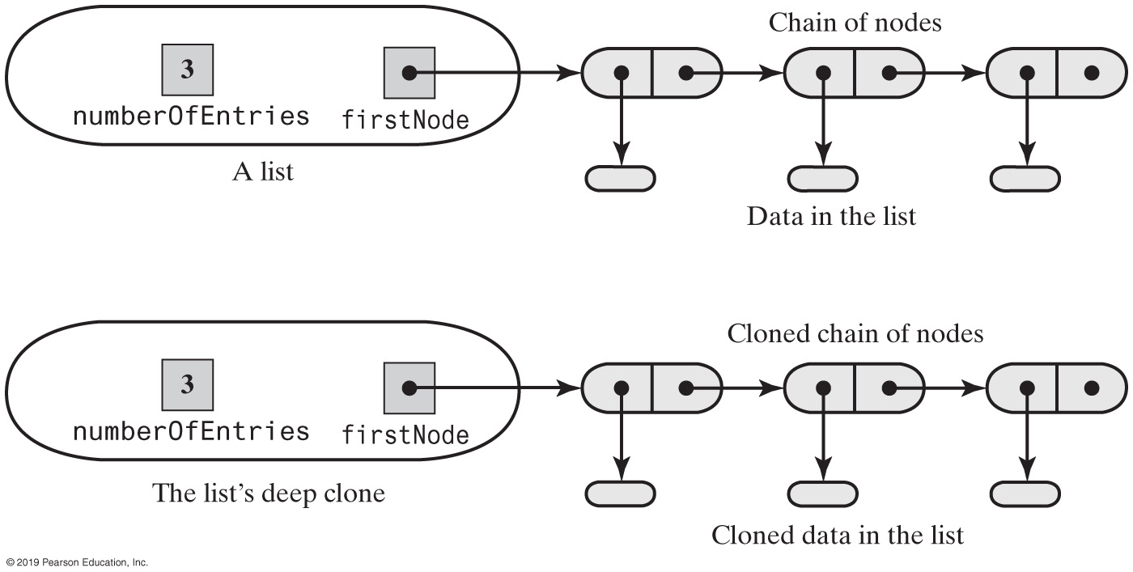
Cloning a Chain
FIGURE J9-6 A list and its shallow clone: linked implementation
FIGURE J9-7 A list and its deep clone: linked implementation

Slide 15
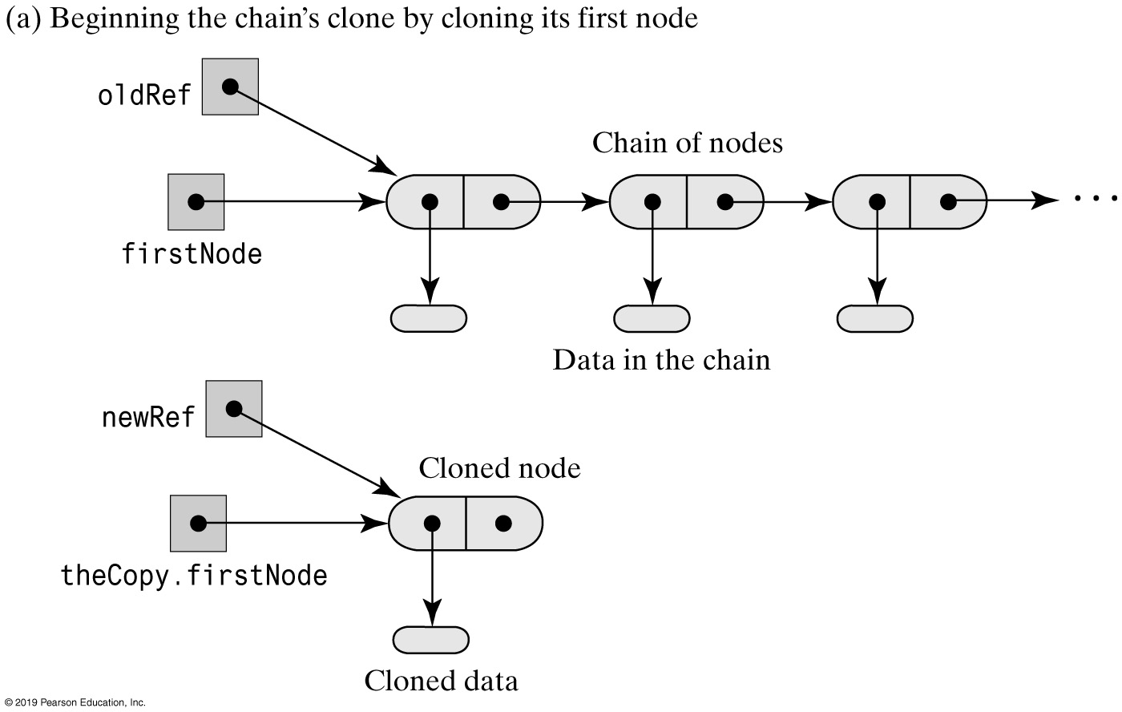
Cloning a Chain
FIGURE J9-8a Cloning a chain of linked nodes

Slide 16
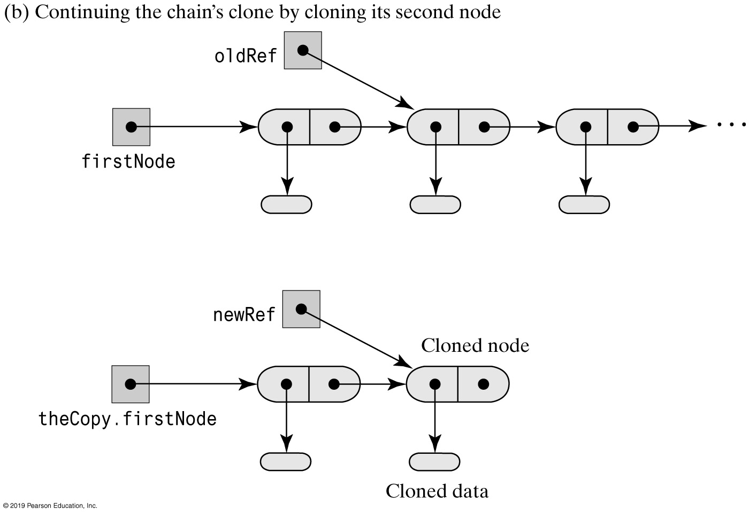
Cloning a Chain
FIGURE J9-8b Cloning a chain of linked nodes

Slide 17
Cloning a Chain - Node Cloning
private class Node implements Cloneable {
private T data;
private Node next;
/* Constructors . . .
Accessor and mutator methods . . . */
protected Object clone()
{
Node theCopy = null;
try
{
@SuppressWarnings("unchecked")
Node temp = (Node)super.clone();
theCopy = temp;
}
catch (CloneNotSupportedException e)
{
throw new Error(e.toString());
}
@SuppressWarnings("unchecked")
T temp = (T)data.clone();
theCopy.data = temp;
theCopy.next = null; // Don't clone link; it's set later
return theCopy;
} // end clone
} // end Node
Revised class Node appears in LList

Slide 18
Cloning a Chain - Linked Chain Cloning (Part 1)
public Object clone()
{
LList<T> theCopy = null;
try
{
@SuppressWarnings("unchecked")
LList<T> temp = (LList<T>)super.clone();
theCopy = temp;
}
catch (CloneNotSupportedException e)
{
throw new Error(e.toString());
}
// Copy underlying chain of nodes
if (firstNode == null) // If chain is empty
{
theCopy.firstNode = null;
}
else
Complete clone method checks for an empty chain.

Slide 19
Cloning a Chain - Linked Chain Cloning (Part 2)
else
{
// Make a copy of the first node
@SuppressWarnings("unchecked")
Node temp = (Node)firstNode.clone();
theCopy.firstNode = temp;
// Make a copy of the rest of chain
Node newRef = theCopy.firstNode;
Node oldRef = firstNode.getNextNode();
for (int count = 2; count <= numberOfEntries; count++)
{
// Clone node and its data; link clone to new chain
@SuppressWarnings("unchecked")
Node temp2 = (Node)oldRef.clone();
newRef.setNextNode(temp2);
newRef = newRef.getNextNode();
oldRef = oldRef.getNextNode();
} // end for
} // end if
return theCopy;
} // end clone
Complete clone method checks for an empty chain.

Slide 20
A Sorted List of Clones
/** An interface for a class of objects that
can be compared and cloned. */
public interface ComparableAndCopyable<T>
extends Comparable<T>, Copyable
{
} // end ComparableAndCopyable
Objects in a sorted list must be Comparable, we also want the objects to be Cloneable

Slide 21
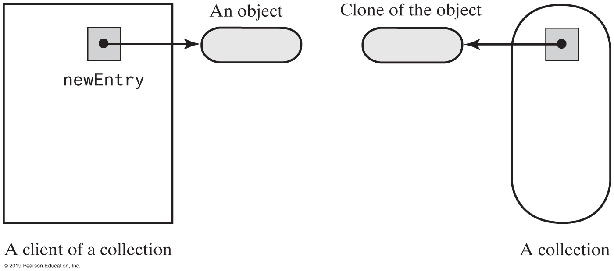
Collections and Cloning
FIGURE J9-9 A collection and its client after the clone of an object is added to the collection

Slide 22
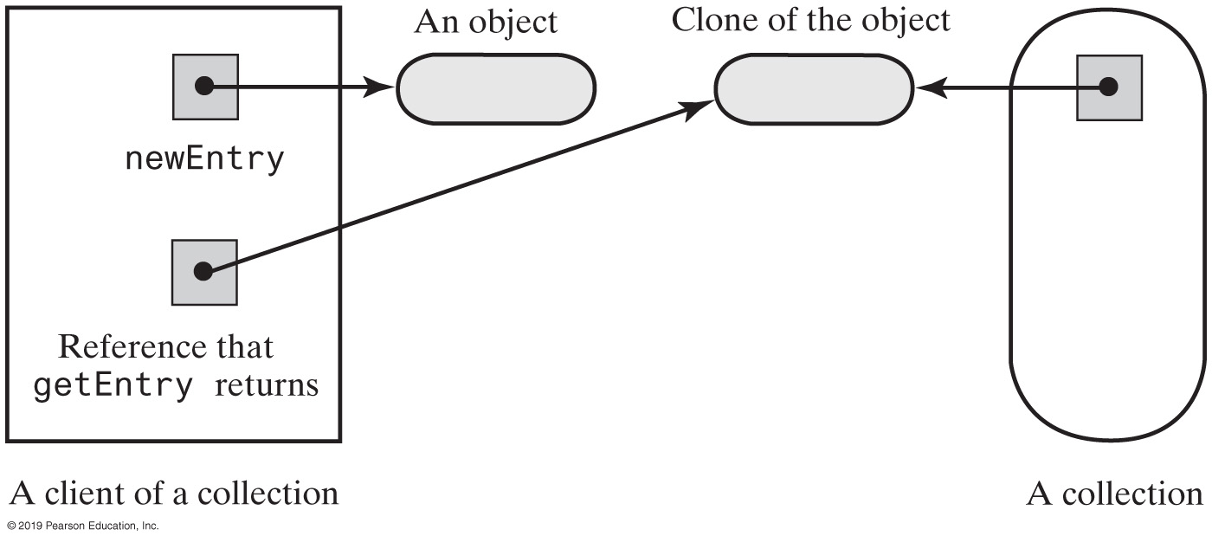
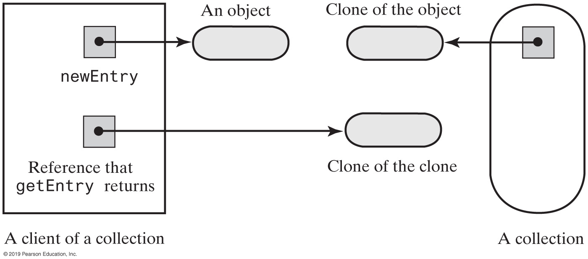
Collections and Cloning
FIGURE J9-10 The effect of getEntry if it did not return a clone
FIGURE J9-11 The effect of getEntry when it returns a clone

